Slide 1
CAR PRICE PREDICTIOn

Slide 2
Problem statement
We have scraped data, using Instant Data Scrapper of 5000 used cars from Cardekho website.
The data set contains the data regarding cars such as- company , variant , model year , gear type , fuel type , no.of photos available in the site, distance covered , place , prices etc.
In this project we tried to access the features that leads to the price of the car and tried to make machine learning prediction model based on those features

Slide 3
Data info
Gsc_col-xs12 src – image source
assured- website
photoNumber src – No.of photos in the website
ImageTransition – image source
views – no. of views on the car
imageTransition src 2 –
model_year – year at which the car was first purchased
company – company of the car
model – model name of the company
variant- variant of the model
emitextCard – stands for EMI
emitextCard 2- for @
emitextaCard 3- EMI of the car
prices price of the car

Slide 4
EXPLORATORY DATA ANALYSIS (EDA)

Slide 5
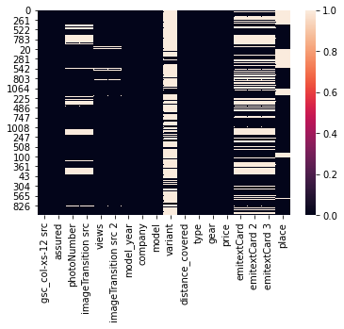
1-Heat map showing the null values in the dataset. Observations- 1-too many null values in variant column 2-Data set is not proper,null values needs to be handled.

Slide 6
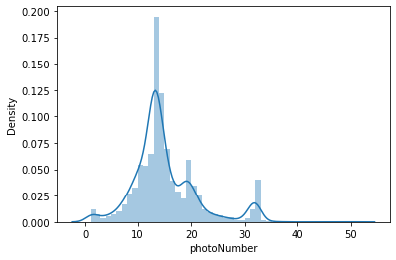
2-Distplot- PhotoNumber observation- 1-most of the cars have 10-15 photos

Slide 7
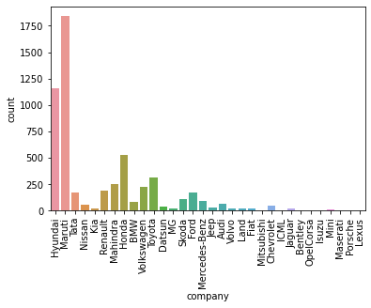
3-Countplot- Company observation- 1- highest number of used cars are of: i-Maruti, ii-Hyundai 2- least number of used cars are of: i-Lexus, Izuzu, Bentley, Maserati

Slide 8
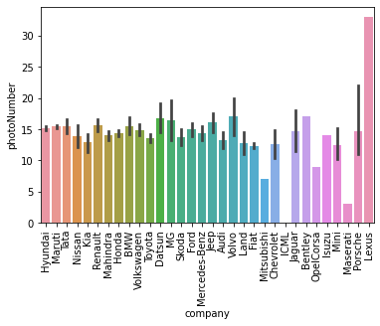
4-Barplot- Relationship between Company and PhotoNumber observation- 1- Lexus has highest number of photos 2- ICML has the least number of photos i.e 0 3- most of the cars have around 13-15 photos at least.

Slide 9
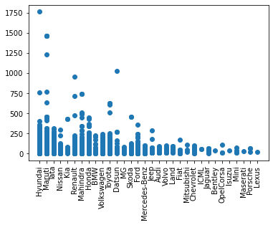
5-Scatterplot- Relationship between Company and Views observation- Hyundai has highest number of views followed by Maruti

Slide 10
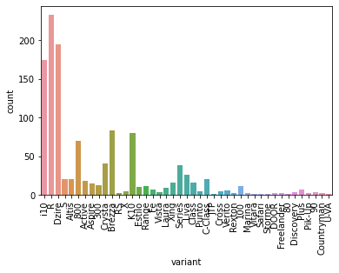
6-Countplot- Variant of cars observation- most number of cars - Wagon R, followed by- Swift Dzire and Hyundai 10

Slide 11
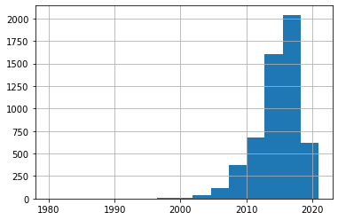
7-Histogram- model_year observation- 1- most of the car models are of the year 2012-2018.

Slide 12
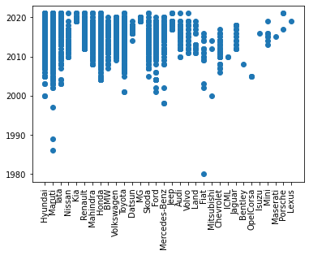
8-Scatterplot- Relationship between Company and model_year observation- most of the car models are of the year 2012-2018

Slide 13
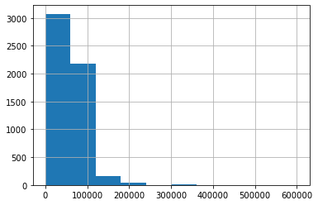
9-Histogram- DistanceCovered observation- 1-majority of cars have covered the distance upto : 0-60000kms 2-followed by cars who have covered the distance upto : 60000-120000kms 3-some cars have even covered the distance upto :350000kms

Slide 14
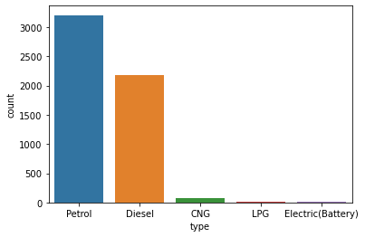
10-Countplot-Type observation- Type - no.of cars 1- Petrol - 3207 2-Diesel - 2177 3-CNG - 75 4-LPG - 10 5-Electric(Battery) - 6

Slide 15
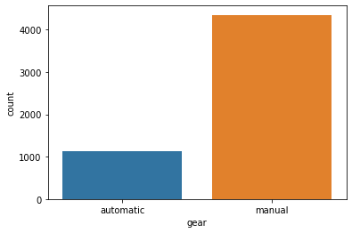
11-Countplot- Type of Gear observation- 1- majority of cars have manual gears- 4352 2- automatic gear cars- 1123

Slide 16
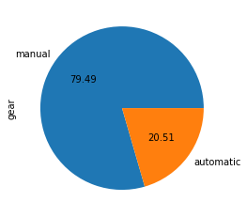
12-Pie Chart- Gears observation- 1- 79.49% of cars have manual gears 2- 20.51%cars have automatic gears

Slide 17
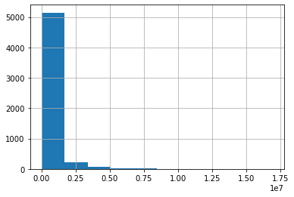
13-Histogram- Price observation- 1- most car prices falls in between: (0-0.17le ) (0.17le= 0.17^10000000=Rs1700000) 2- some cars also have price ranging between:(0.50le-0.80le) or (Rs5000000-RS8000000)

Slide 18
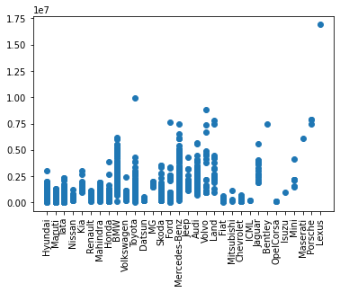
14-Scatter- Relationship between Company and Price observation- 1- Lexus car have the highest price 2- Hyundai,Maruti,Tata, Mahindra,Honda cars have moderate prices 3- Toyota have the 2nd highest car price

Slide 19
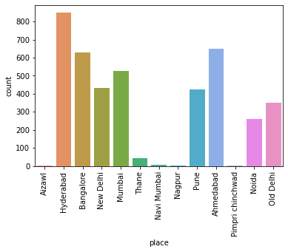
15-Counplot- Place observation- 1- the dataset contain cars mostly from Hyderabad region followed by Ahemdabad, Bangalore, Mumbai, NewDelhi,OldDelhi, Noida respectively.

Slide 20
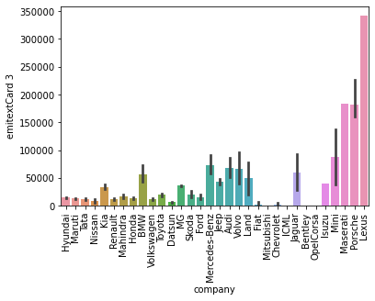
16-Barplot- Relationship between Company and their EMIs observation- 1- companies with high EMIs: Lexus , Porsche , Maserati respectively 2- 2- Hyundai ,Tata , Maruti , Honda , Datsun , Chervolet have low EMIs around Rs(5,000-20,000)

Slide 21
Data Pre-processing-
Data pre-processing of Feature Scaling involves-
Filling NaN values.
Selecting x=feature variable, y=target variable
Encoding the x variable using Ordinall Encoder, to change the categorical values into numerical values.
Outliers removal was done using zscore method.
Skewness removal from skewed column using log or sqrt transformation.
Scaling the DataFrame- we used StandardScaler for scaling feature variables

Slide 22
Model Selection
After selecting the x and y variable,we then perform the train_test_split and and check the training and testing in various models.
Models used – LinearRegression, DecisiontreeRegressor, KNeighborsRegressor, SVR, RandomForestRegressor, AdaBoostRegressor, GradientBoostRegressor,
Train_test_split was used to find out the accuracy of each model.
After this cross_val_score of each model was calculated.
By compairing the accuracy score with cross_val_score, GradientBoostRegressor was found to be most efficient model.
After this Hypertest tuning was done through GridSearchCv to find out the best parameter for GradientBoostRegressor.

Slide 23
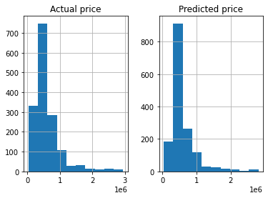
Conclusion
With the best parameters GradientBoostRegressor worked with 89% accuracy.
Predicted value was compared to Actual value using histogram

Slide 24
Limitations of model
The model is working with 89% accuracy
The predicted values are not to be taken as true values
There is margin of 10% error in the predicted values.

Slide 25
Thank You submitted by: Akashdeep Singh Manral Batch:1834

